Slide 1

Value management
Value creation and preservation for your stakeholders

Slide 2

The experience of many managers regarding risk management?
Risk
management

Slide 3

Many associate risk management with compliance burden

Slide 4


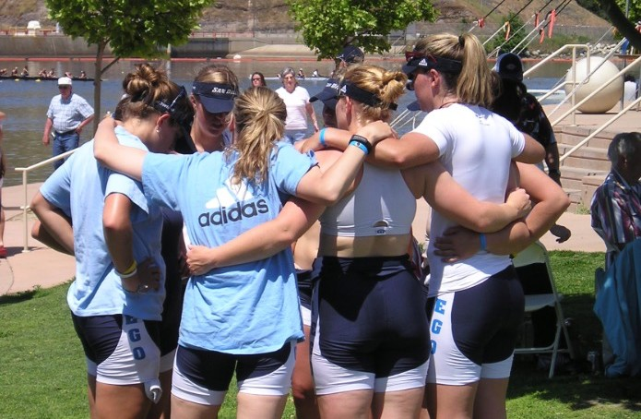
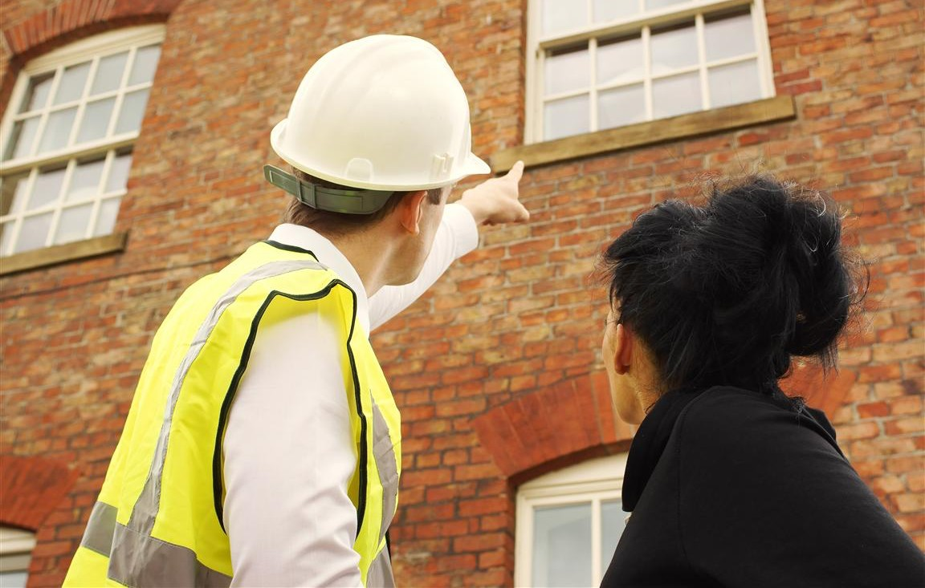
Quite a lot is expected from your management team …
exploring outside world
getting results
bringing people together
ensuring control

Slide 5

How do you get this organized as a team?
utilizing everyone’s expertise

Slide 6

Managing expectations implies seizing opportunities and managing risks
beter decision making under uncertainty

Slide 7


It asks for dedicating time to work on modifying your internal organization
creating and preserving lasting value

Slide 8

Adjusting requires insights in your relevant stakeholders, their interests and their power
financiers clients, consumers
governments legislators, regulators neighbours
suppliers, producers collaboration partners employees
interest groups

Slide 9

The key question remains whether your main stakeholders remain enthusiastic about the way you operate
exceeding expectations through timely modifications

Slide 10

Value management enables your team to generate and protect lasting value for your stakeholders
using a common change agenda based on shared choices

Slide 11
What do you primarily mean by ‘value’, ‘success’, ‘improvement’?
higher returns?
more ethical?
etcetera…
greener?
safer?
bigger?
stronger?
faster?
simpler?
more innovative?
more careful?
cheaper?
more sustainable?
respectful?
shorter?
more
more cost eﬀective?
more
beautiful?

Slide 12

Value management looks at chances for value and threats to value in conjunction
threats
risk management
opportunities
performance management

Slide 13

There are many specialists involved with the many opportunties and threats within your organization….
Public relations
Human resources
Legal affairs
Insurances
Compliance management
Customer service
Finance
ICT & information security
Marketing
Research & development
Mergers & acquisitions
Facility management
Maintenance
Fraud prevention
Training & development
Quality & safety
Treasury
CSR
Risk management
Controlling
Continuity management
Etcetera….

Slide 14
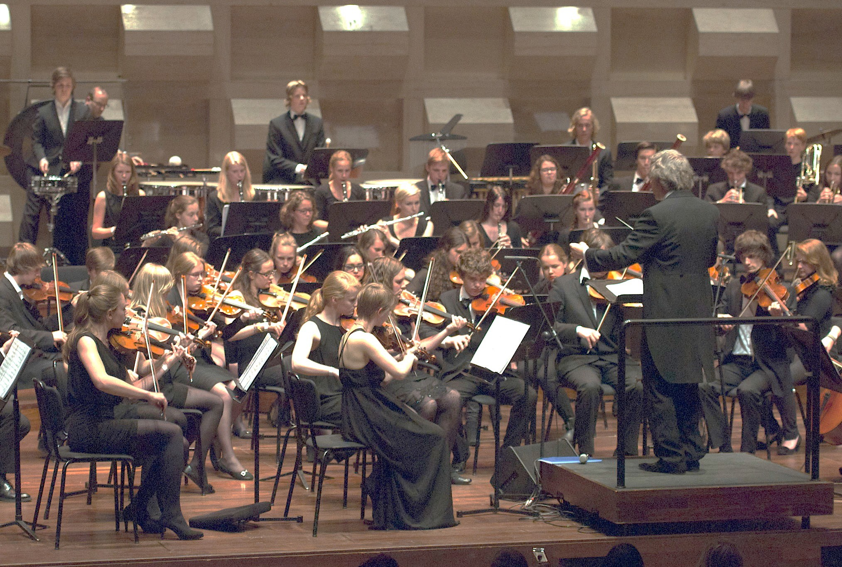
Value management offers you the common platform for aligning all those specialists
clear roles and contributions of all players

Slide 15
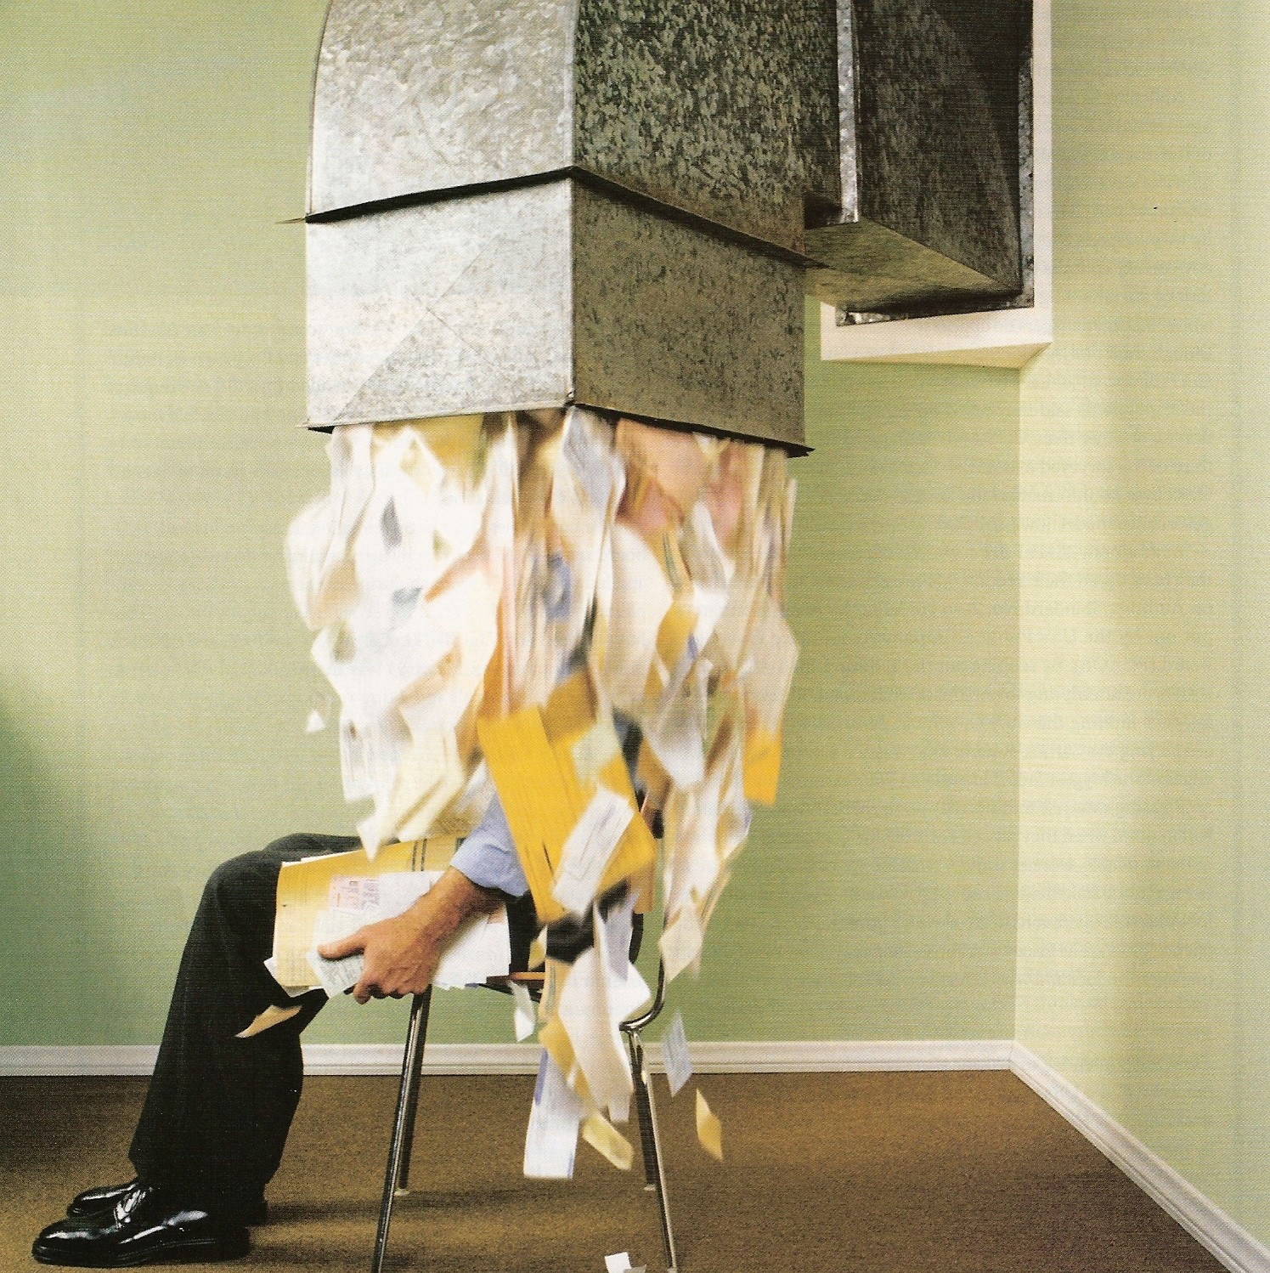
Without effective alignment your well-meant internal rules suffocate your colleagues
policies
mgt. contracts
charters
guidelines
•
•
•
•
•
•
procedures
protocols
instructioms
manuals
account manager
working standards
etcetera

Slide 16
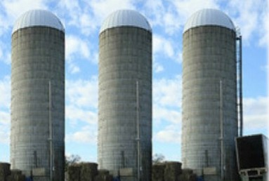






Focusing on het bigger picture helps your colleagues to fight ‘functional’ compartmentalization
Information security
Quality & safety
Compliance

Slide 17


Value management focuses on your customer serving colleagues and not your regulators
risk management
value management

Slide 18

Do your staff functions unburden your client serving colleagues?
internal legislator or servant?

Slide 19
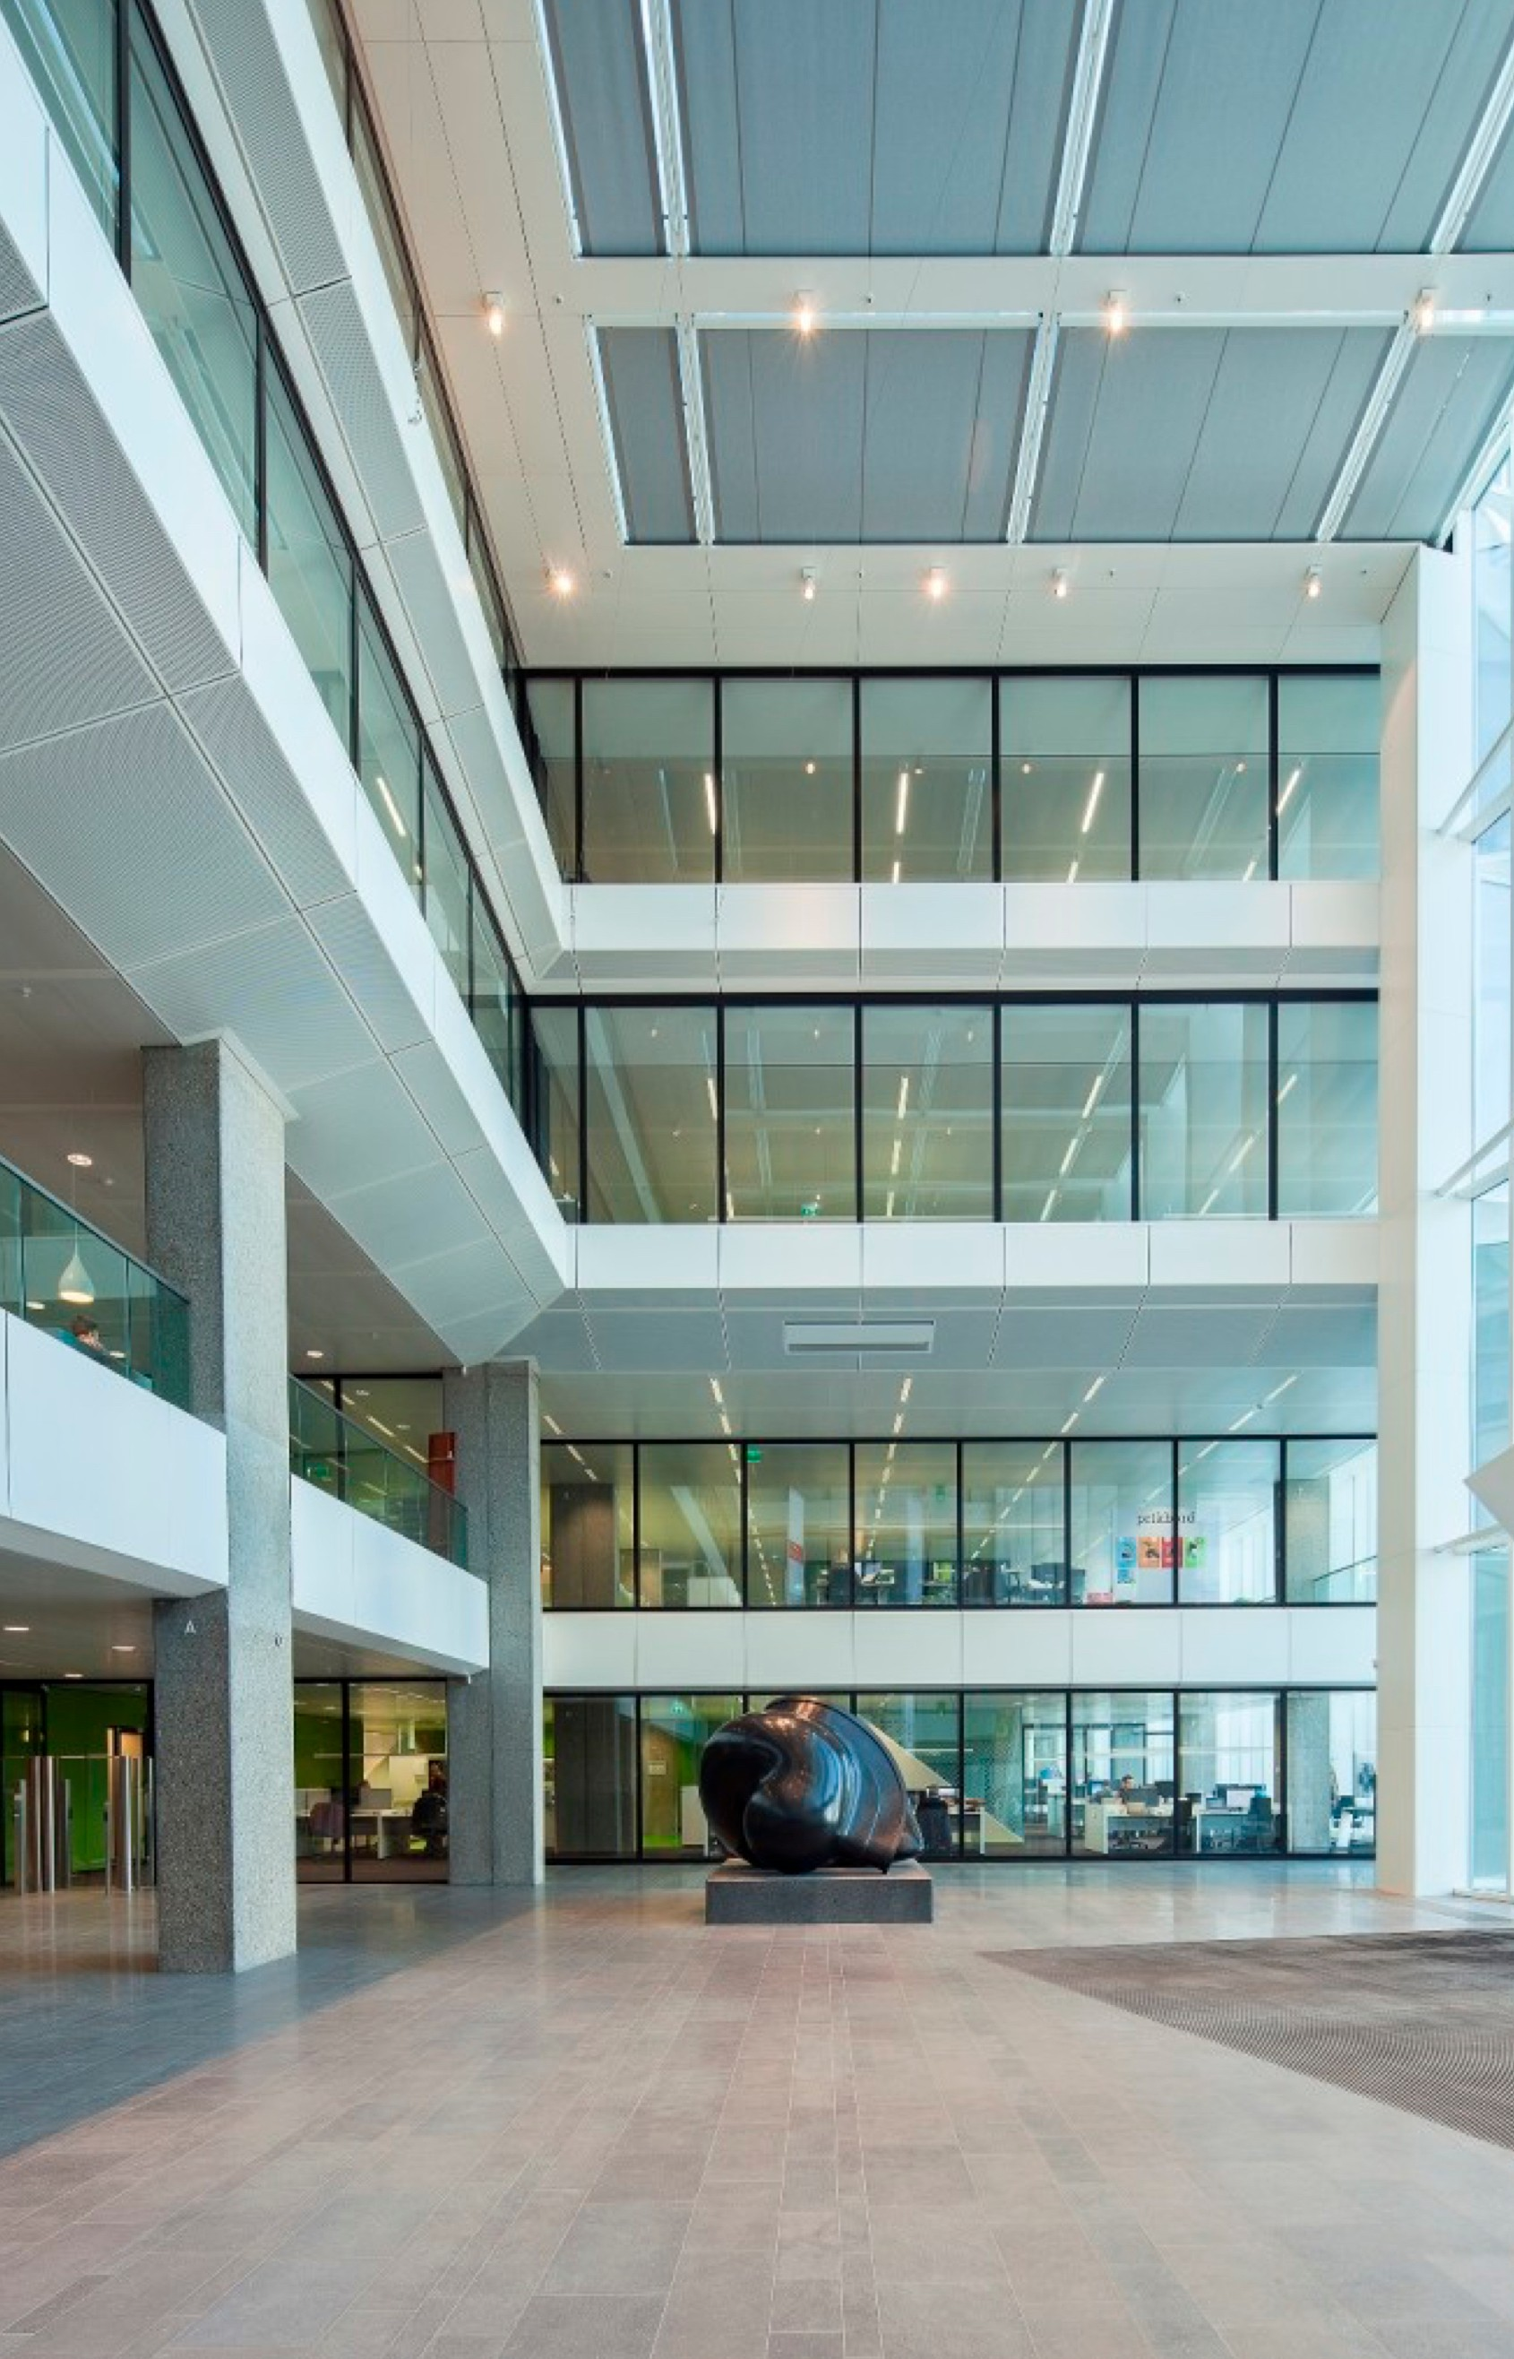
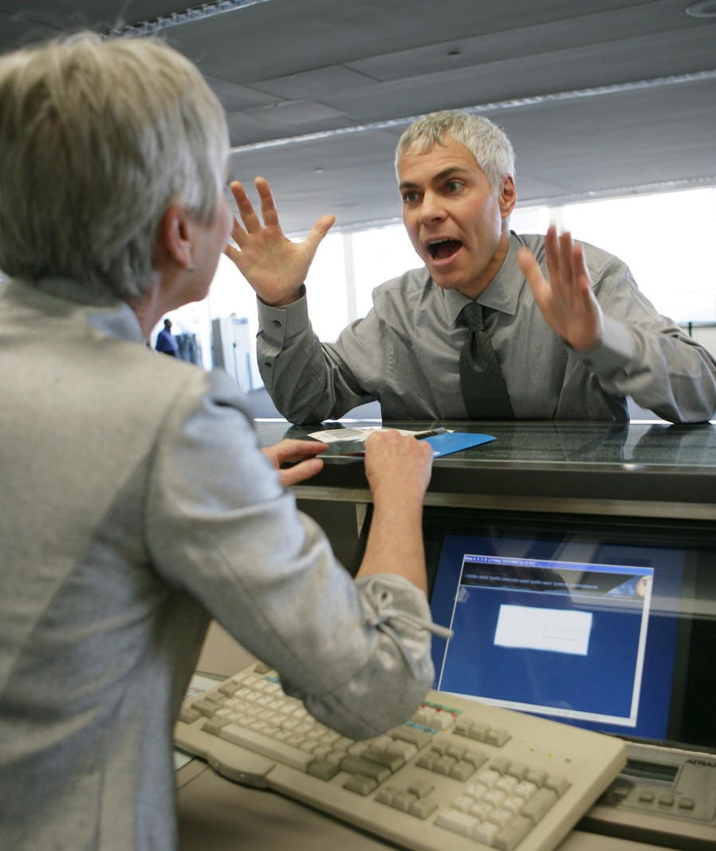
Value management helps your head office to actively support value creation for your clients
boundary designers
professionals

Slide 20

It starts with what your vision, mission, strategy en objectives are all about
which targeted value for which stakeholders?

Slide 21

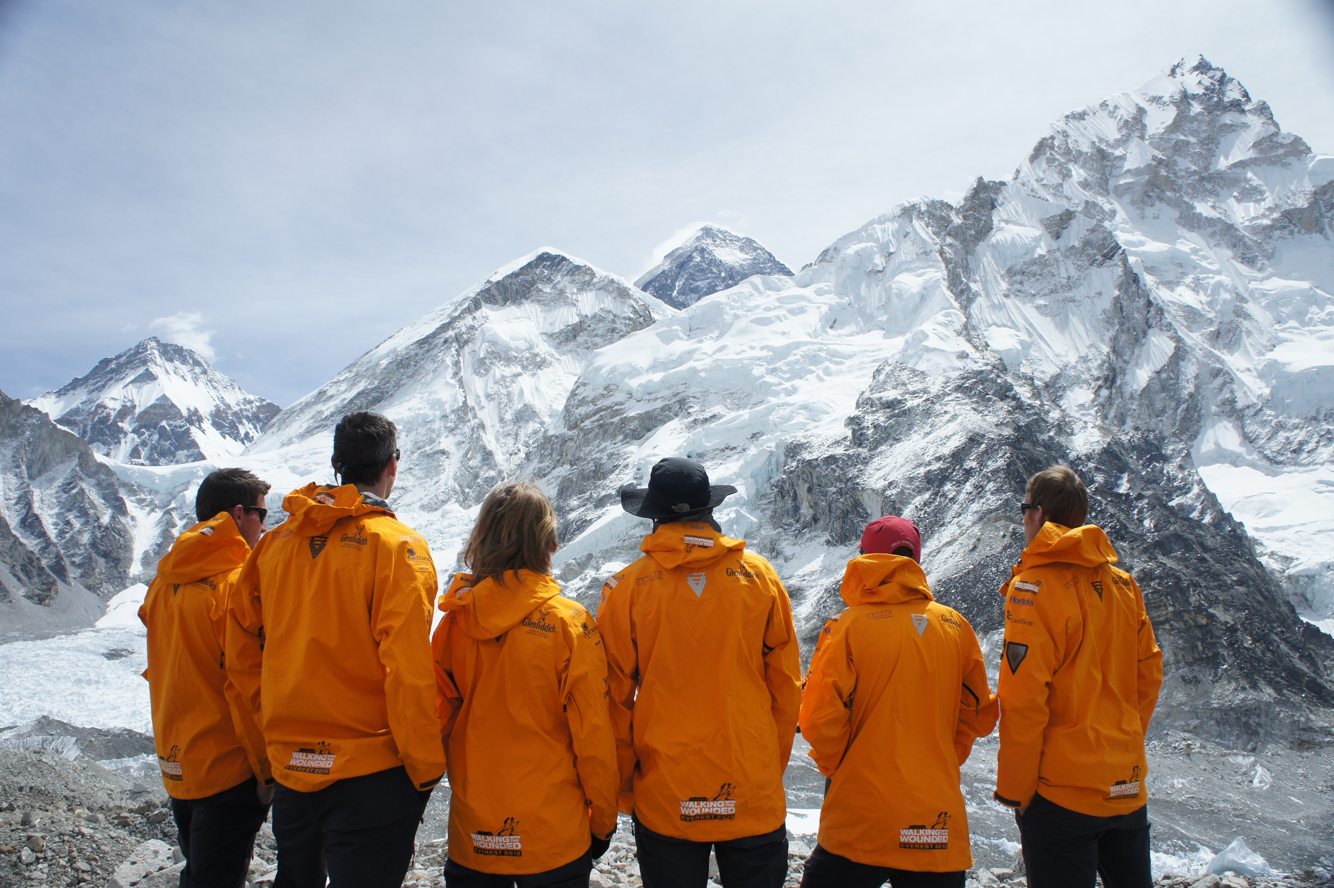
The clearer is the focus on your common goal, the easier are the adjustments of your organization
welke beoogde waarde voor welke stakeholders?
determining together what you need to improve

Slide 22
You and your colleagues make decisions based on core values; essential to include them in your discussions
vision mission strategy objectives core values
True North

Slide 23

Since you don’t need to do everything, it is important to clarify the scope first
applicable at any level within your organisation:
holding, group
subsidiary, division
country, region
location, area
department, function
project, initiative

Slide 24
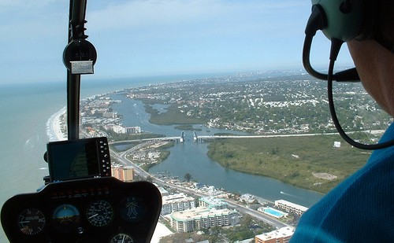
Overview provides you with insights; hence a visual representation of your daily activities comes in very handy
a helicopter view for your management team

Slide 25
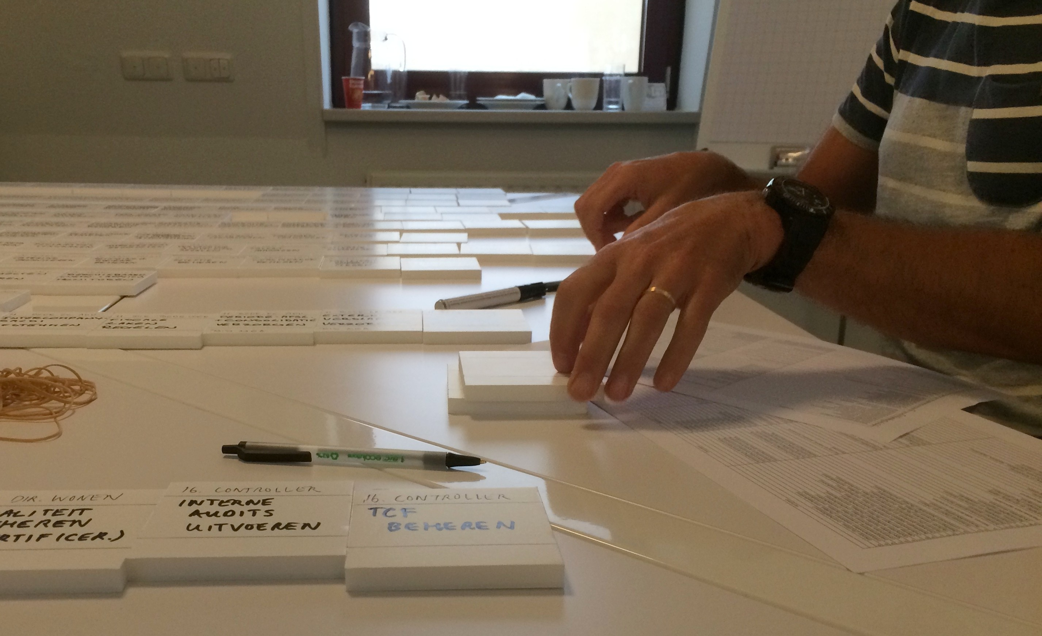
A ‘map’ of all relevant activities constitutes the common playground for your team
managerial, primary and support responsibilities

Slide 26
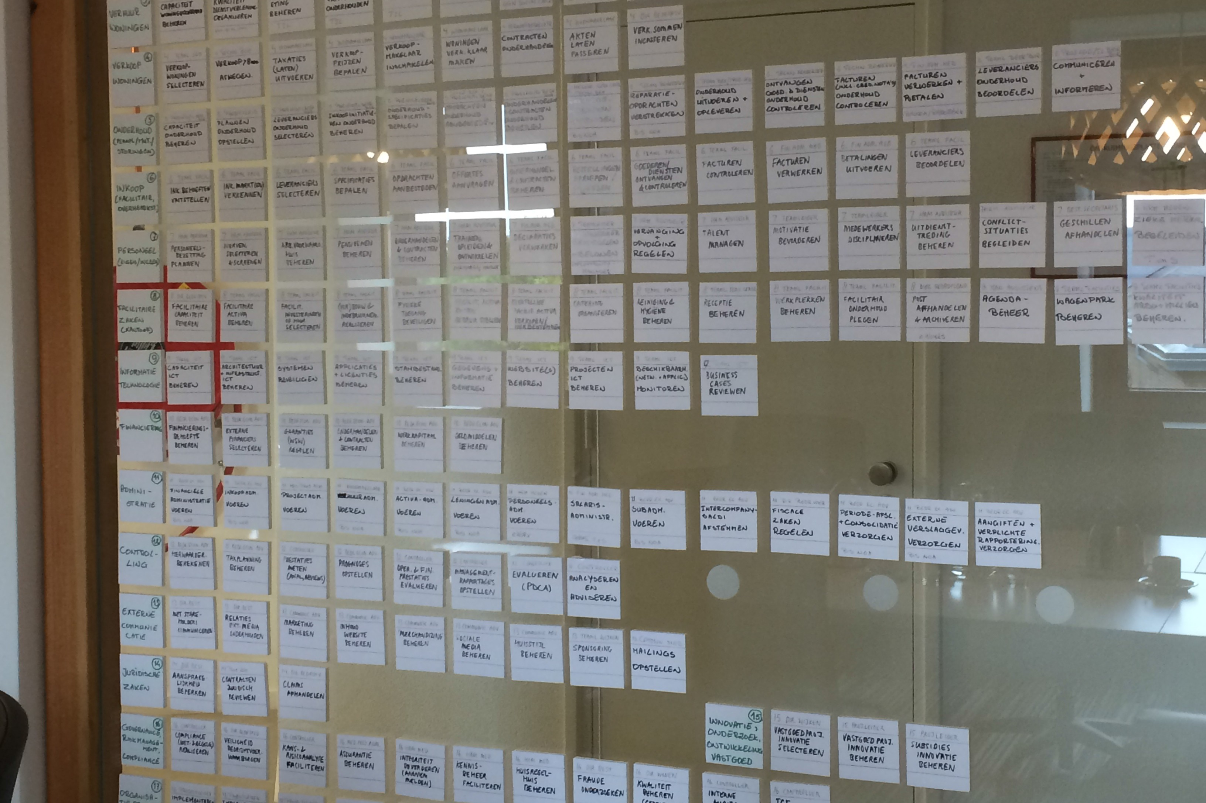
The overview is recognizable for everyone and shows the interrelationship between everyone’s contributions

Slide 27

The oveview creates awareness of the mutual dependencies in your daily activities
clarifying the responsibilities by activity

Slide 28

Insight in your colleagues’ activities is the basis for understanding their dilemmas
laying the puzzle of your organization together

Slide 29
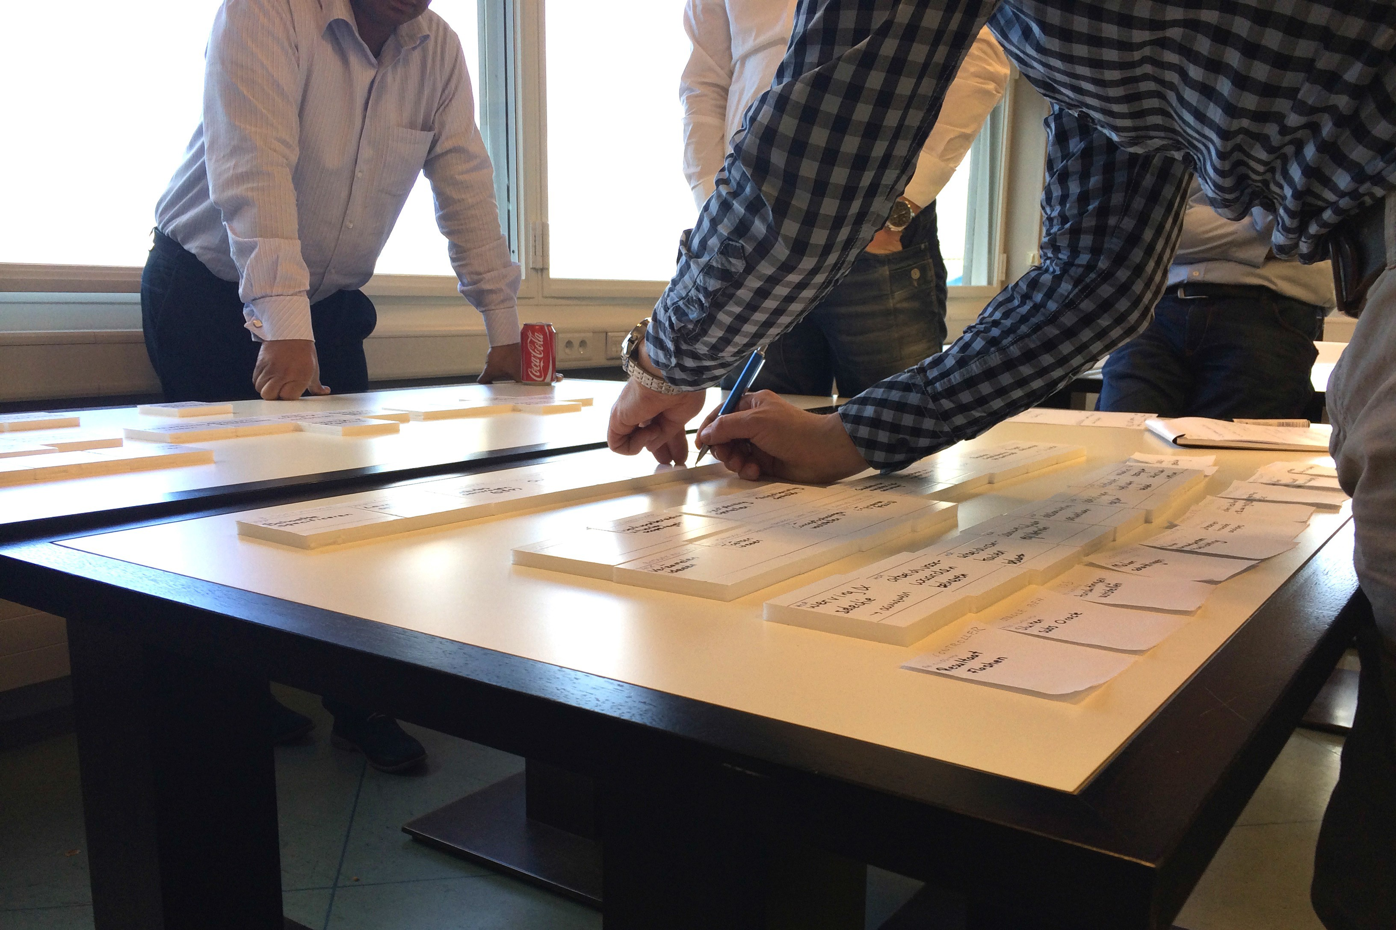
The ‘map’ helps your colleagues to analyze their contribution to the clients’ experiences
focus on those serving your clients

Slide 30
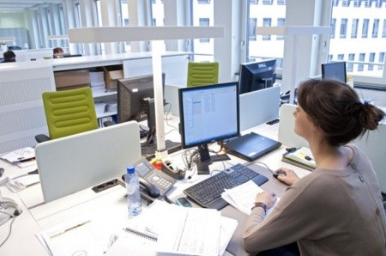
The true meaning of your opportunities and risks becomes clear in the daily activities
knowing who does what is the basis

Slide 31

Opportunities and risks always go hand in hand,
e.g. a welcome new customer, who doesn’t pay
opportunities
risks
requiring a holistic approach

Slide 32
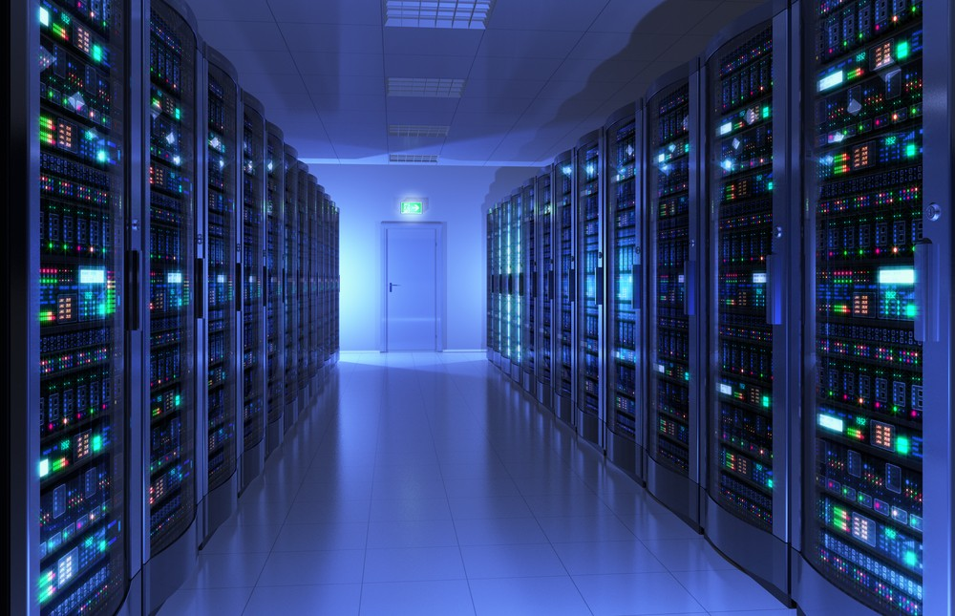
Meeting the expectations asks for a topical insight in the vulnerability of your essential assets
critical analysis of your vital infrastructure

Slide 33




Risks never stand alone: as a decision maker you always have to balance the ‘pros’ and ‘cons’
chances and threats impact stakeholders

Slide 34
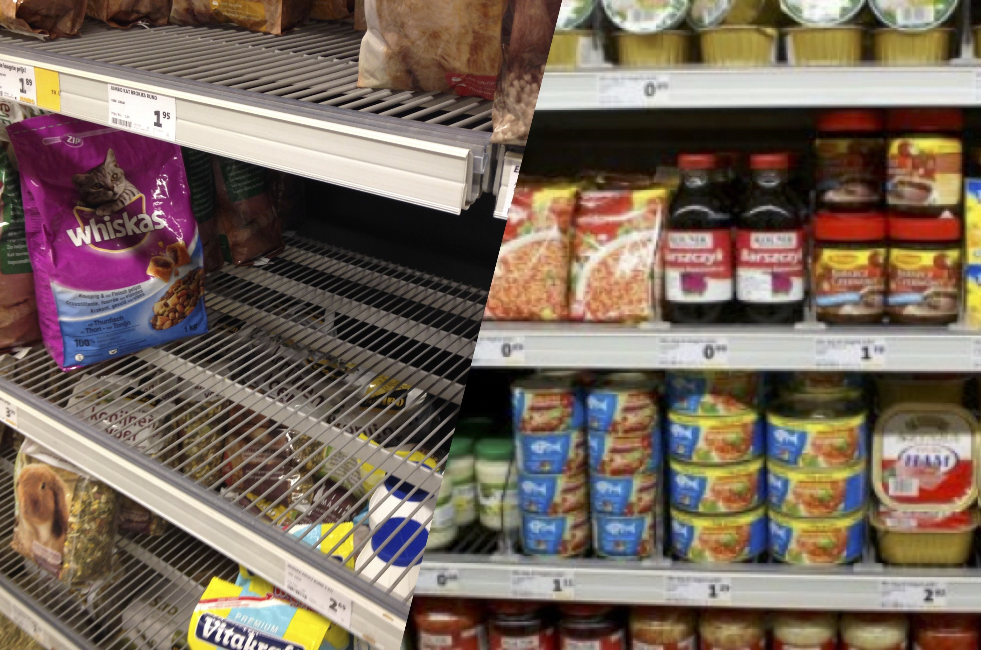




Every decision is a matter of balance, e.g. stock levels
missed revenues
working capital demands

Slide 35

Do you and your people have access to adequate information for decision making?
central role of business intelligence

Slide 36






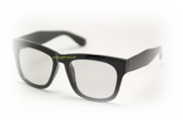
Where you see opportunities and risks depends on your ‘spectacles’; know your dominant perspectives
continuity safety
integrity
sustainability return
speed etcetera….

Slide 37
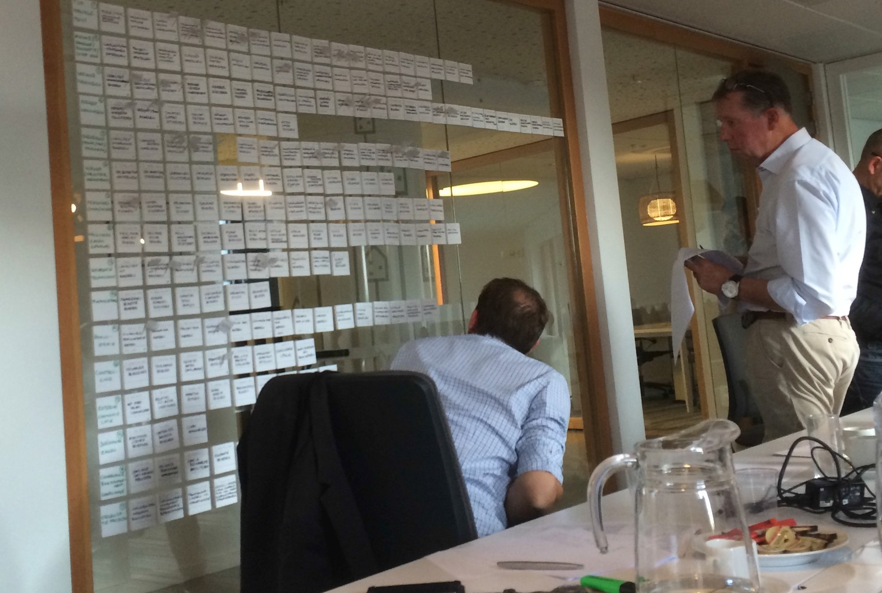
The ‘map’ is the basis for the identification and prioritization of your specific improvement opportunities
.
.
.. .
.
. . .
.. .
better seizing opportunities and managing risks

Slide 38
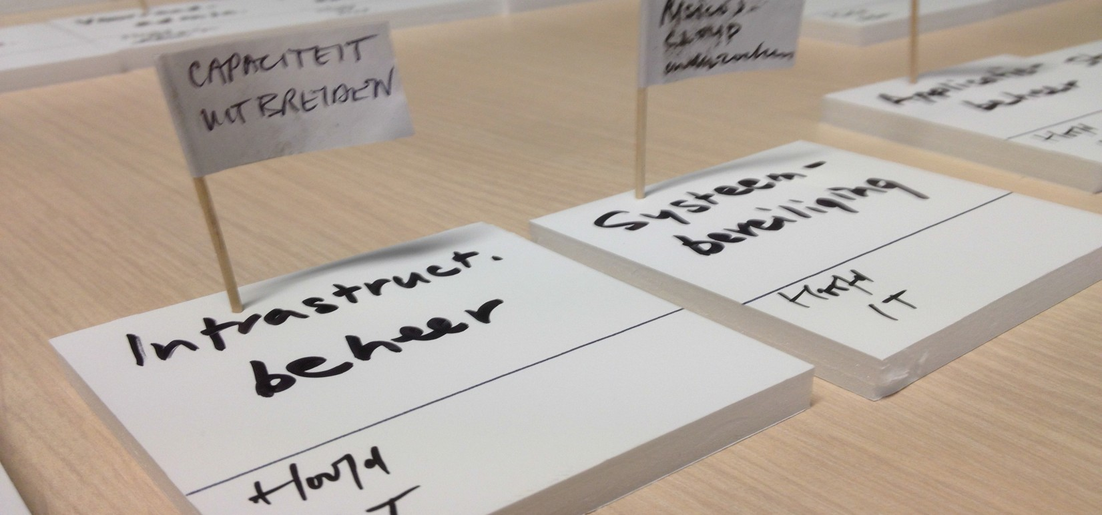


The improvement opportunities can be made visible on the map quite easily
Gezamenlijk inventariseren
‘renovations’ aimed at value creation and preservation

Slide 39

You can build on your existing policies: your internal appointments about value creation and preservation
regulating or leaving it to someone’s own discretion?

Slide 40





















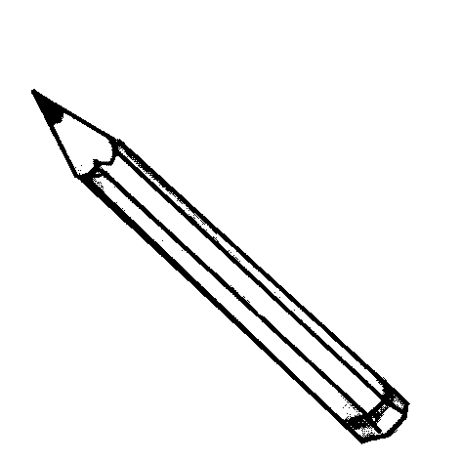













Value management helps with determining the right frameworks and degrees of freedom
|||||||
release
have them decide
recommend
give suggestions
prescribe
impose rules

Slide 41
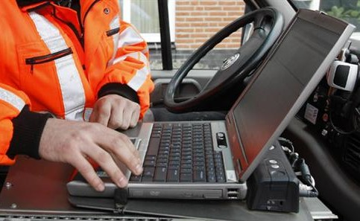

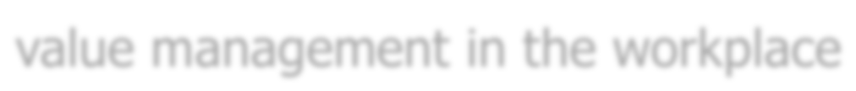
Always design your control measures bearing in mind the perspective of your client serving colleagues
value management in the workplace

Slide 42
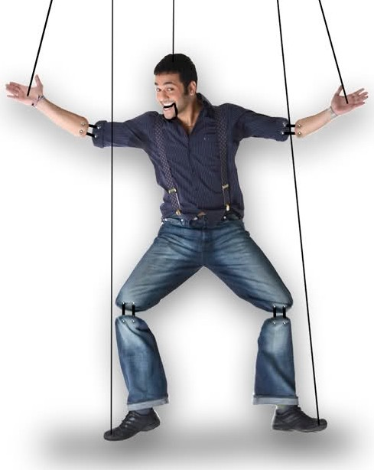

Mandate is about finding the right balance between control and trust
controlling releasing

Slide 43
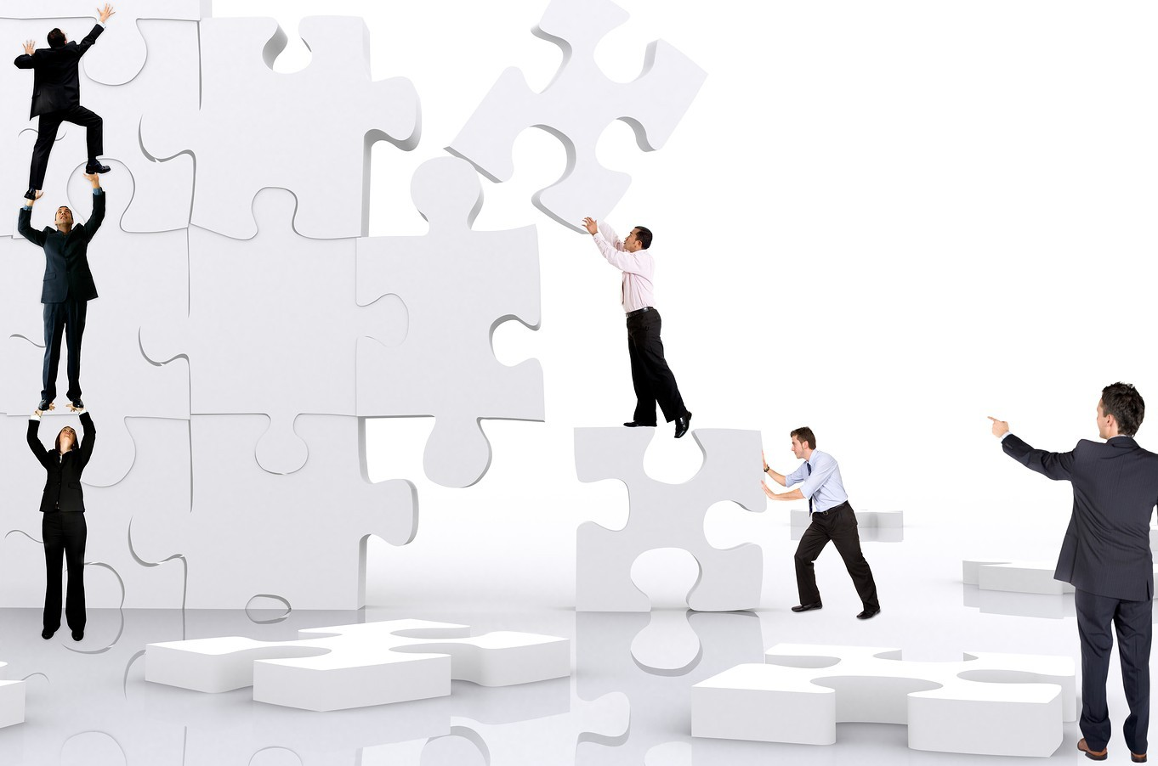
The quality of your team’s cooperation determines the effectiveness of your transformation process
realizing the scheduled ‘renovations’ together

Slide 44


Create a work environment in which your people can safely report unwelcome news
hear, see and do not keep silent
hear, see and do not keep silent

Slide 45

In summary: value creation and preservation is about how your team organizes itself and works together
well organized internally: getting in lane for success!

Slide 46
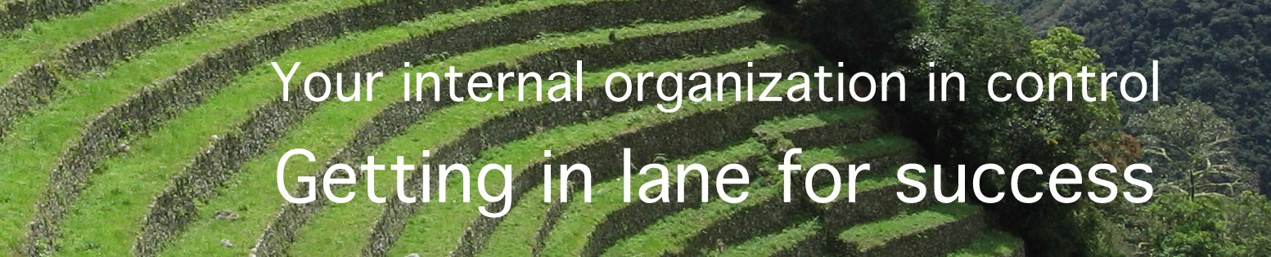
MdP | Management, Consulting & Training
Marinus de Pooter
E: marinus@mdpmct.com M: 06 52 06 21 66
v.2015.10.23

